Slide 1
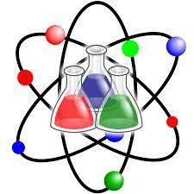
Observing change
Chapter 14

Slide 2
How many times can you physically change a piece of paper

Slide 3
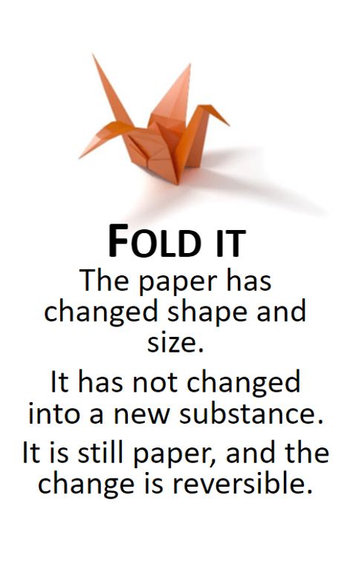
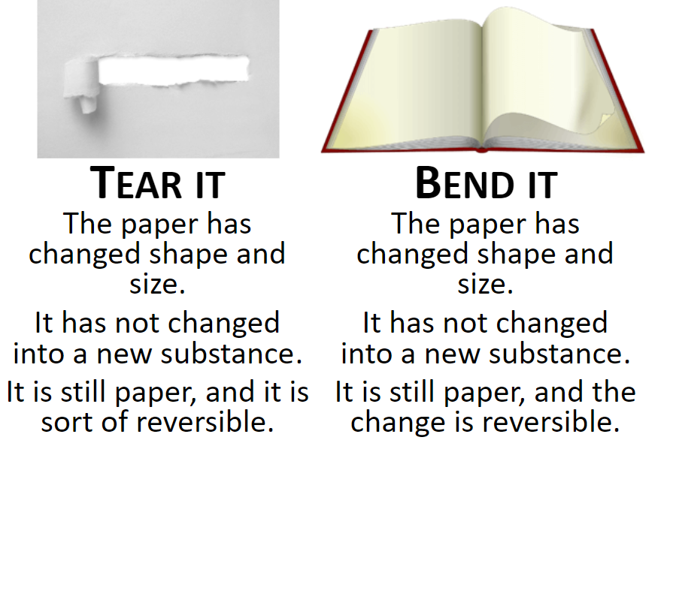
How many times can you change a piece of paper

Slide 4

Are these physical or chemical changes
Physical
Physical
Physical
Chemical

Slide 5
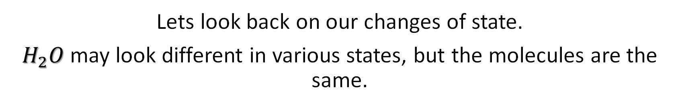
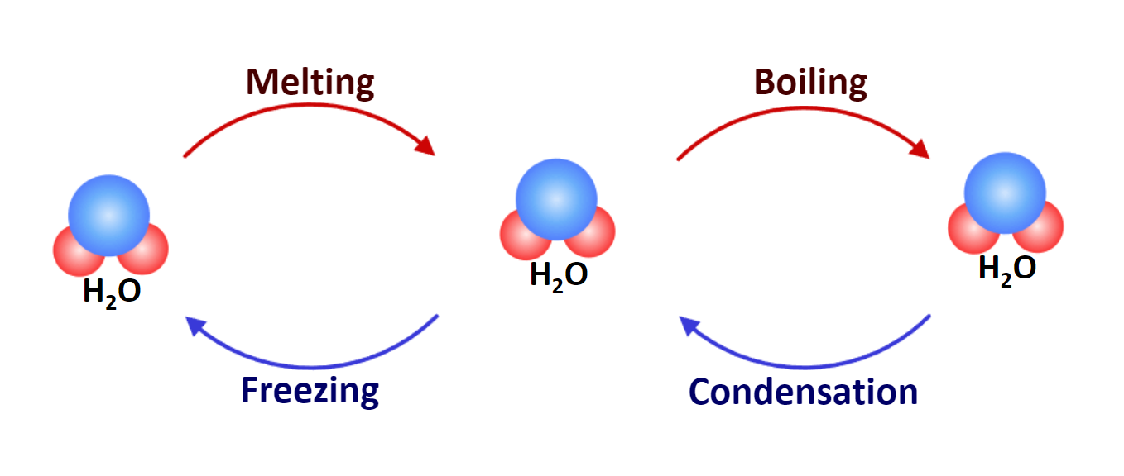
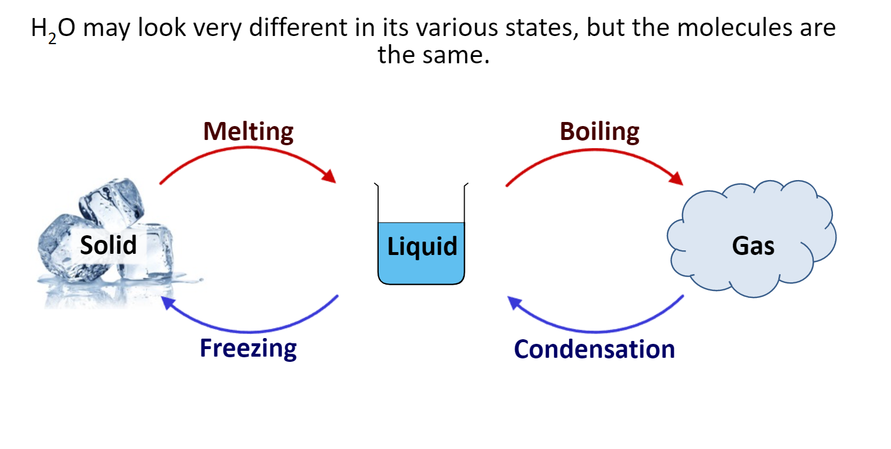
Physical change
Physical change
Is a change that does not result in the formation of any new substances.

Slide 6
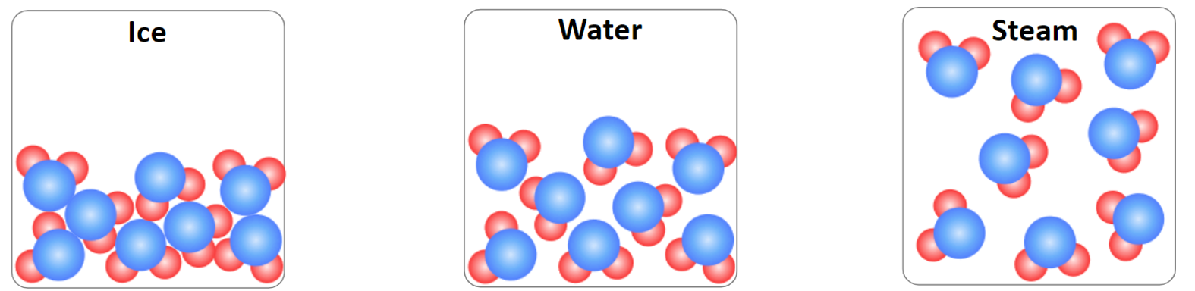
Physical change
When changing state, no chemical changes take place and no chemical bonds are created or broken.
No new substance is formed.
Usually no energy changes take place.
Physical change is normally reversible

Slide 7
Chemical change
Chemical change
Is a change that results in the formation of one or more new substance
During a chemical change energy may be released or absorbed.
Notes:
What are 5 chemical changes?
The five conditions of chemical change: color change, formation of a precipitate, formation of a gas, odor change, temperature change
However, the changes in cake mixture are not just brought about by mixing or heat. Chemical changes also occur. Materials, such as egg and flour, are made up of chemicals that change to produce a new substance—in this instance, cake. It is an irreversible change.

Slide 8
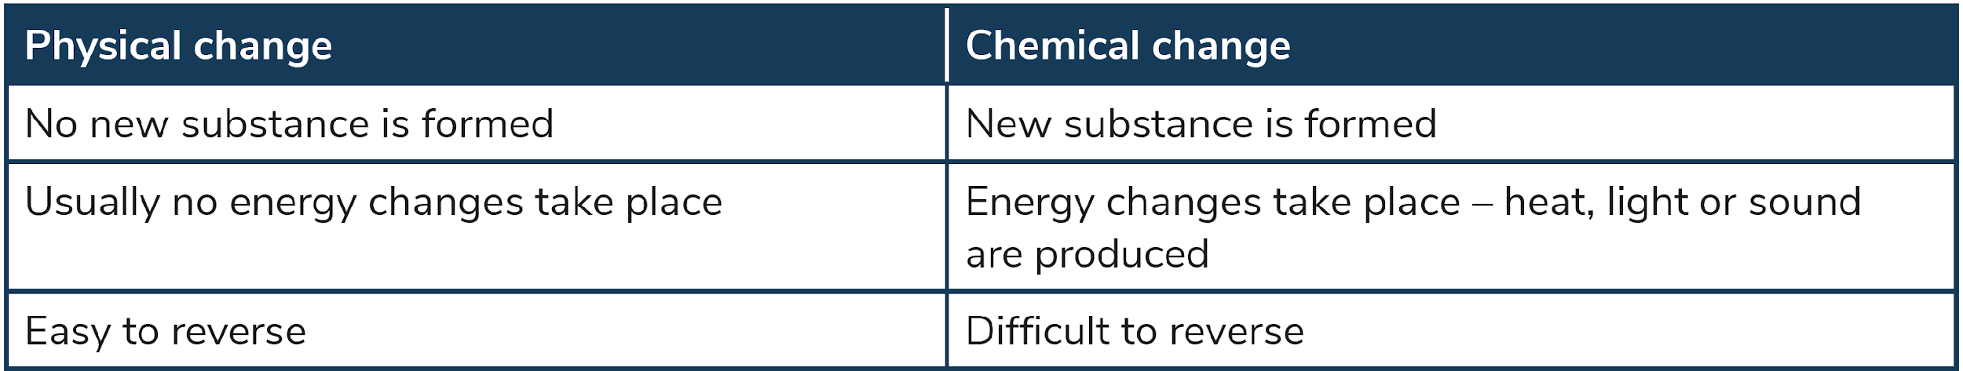

Slide 9
Chemical change – Exothermic and endothermic processes
When a substance changes state, the particles in the substance either gain energy or lose energy.
Exothermic:
A process that involves heat being given out.
Endothermic:
A process that involves heat being taken in .

Slide 10
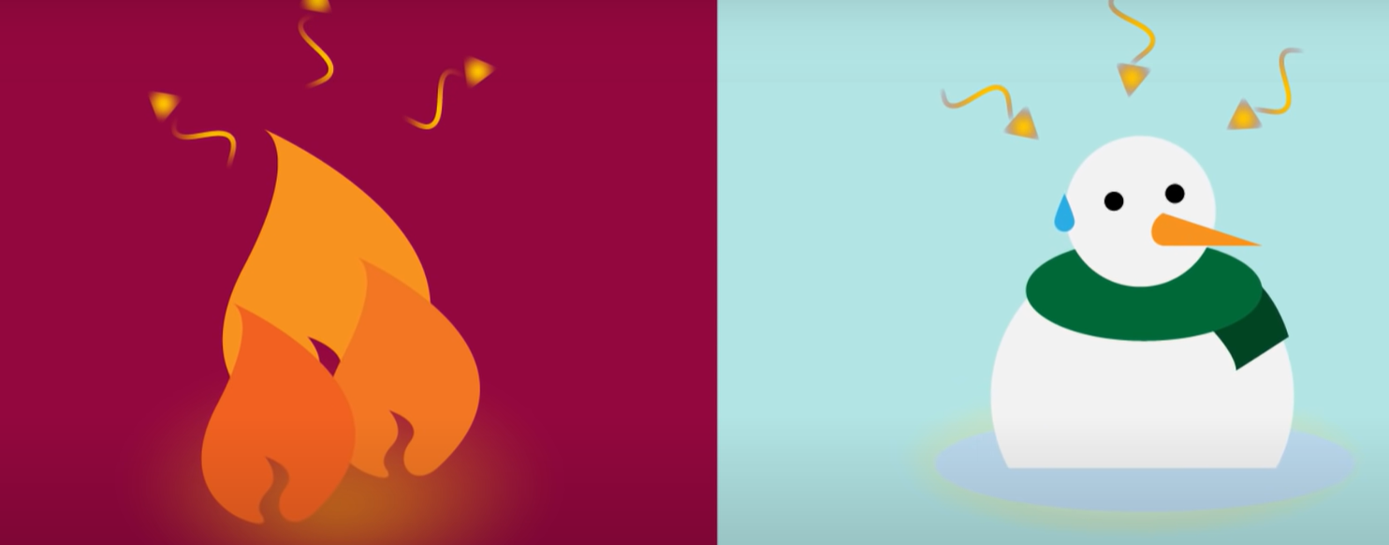

Slide 11
Observing change
Observing change:
During a chemical reaction the atoms rearrange to form a new substance.
There are some signs that indicate this has occurred:
Colour changes
Temperature changes
Light is emitted
Bubbles of gas are produced.

Slide 12
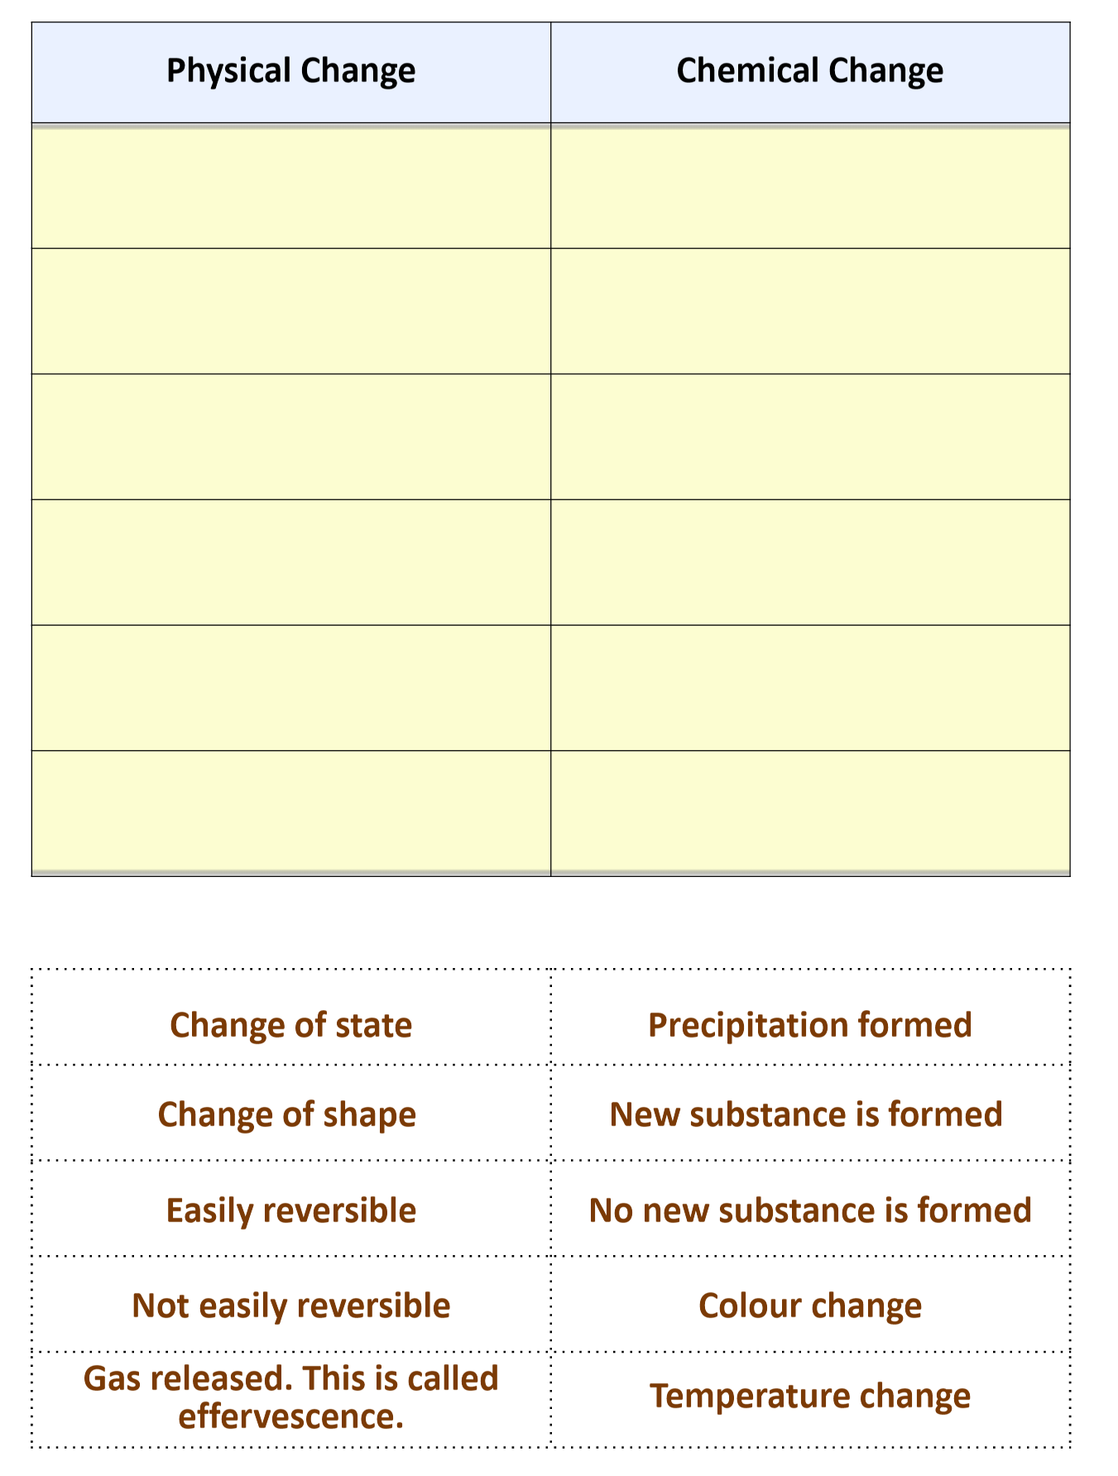

Slide 13
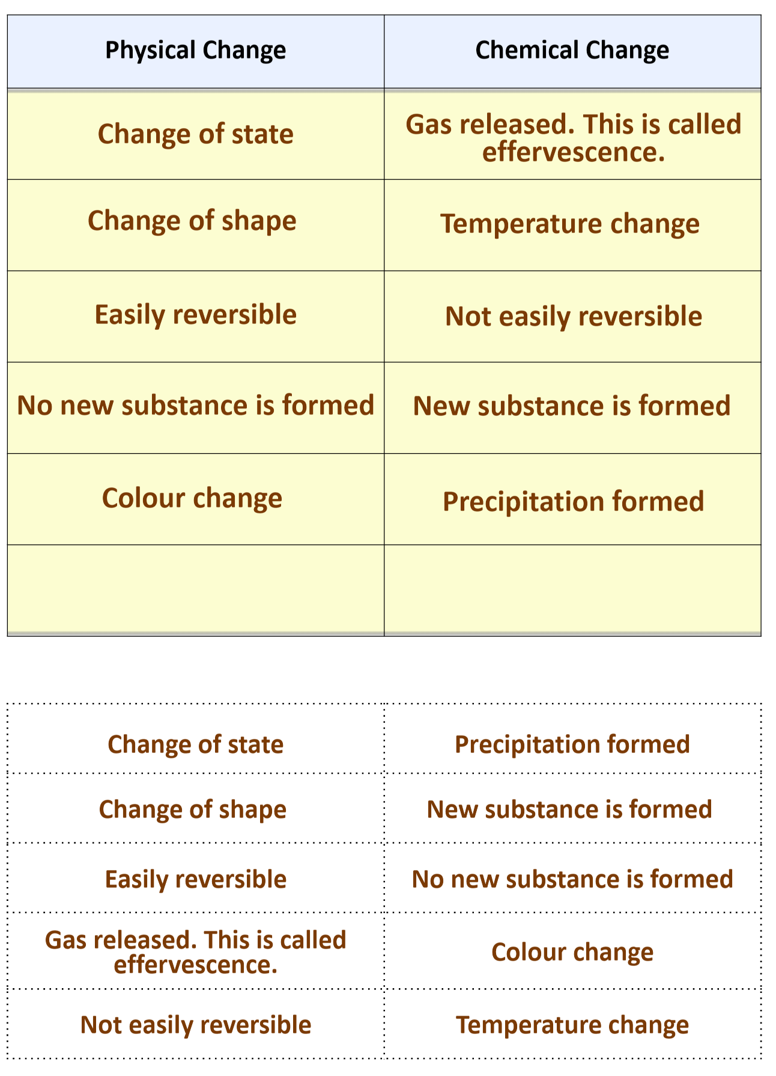

Slide 14
Chemical reactions
Chemical reactions:
The chemicals that react together are called reactants and the substances formed are called products.
Chemical changes are also known as chemical reactions.
Chemical changes or chemical reactions are represented using equations.
There are two types of equations: word equation or chemical equation.

Slide 15
Chemical reaction
Reactants
Products
(Hydrogen) H₂
(Oxygen )
O
(Water )
H₂O
Reactants:
Are the substances that are present before the chemical change takes place
Products :
Are the substances that are formed after the chemical change takes place
Reactants on the left
Products on the right

Slide 16
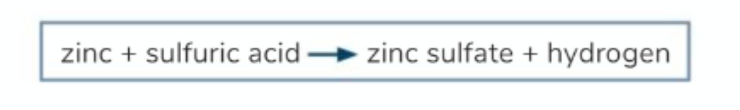

The following equation represents the reaction between zinc and sulfur acid
What does the + sign mean
What does the mean
Name the reaction and the products

Slide 17
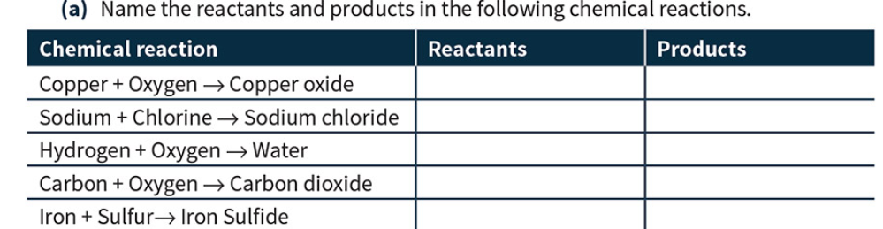

Slide 18
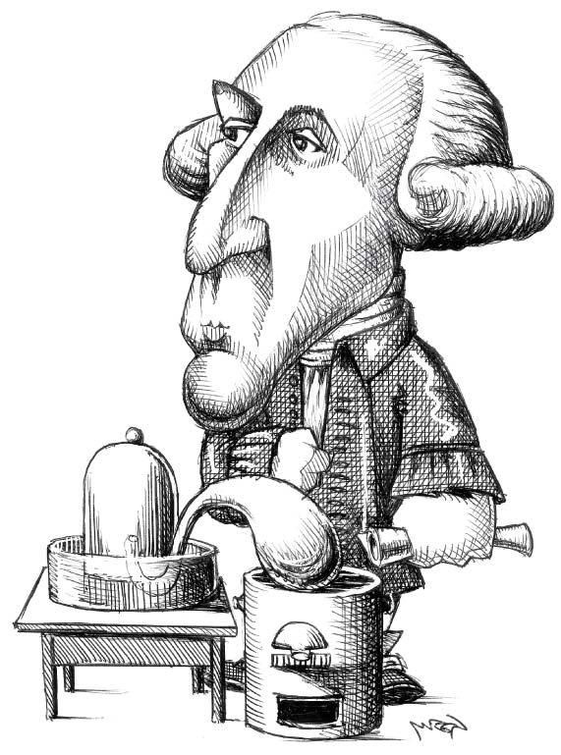
Law of conservation of mass
Law of conservation of mass:
Mass of a substance cannot be created or destroyed, so during a physical and chemical change there is no change in the overall mass.
Antoine Lavoisier, a French chemist in the 18th century, discovered the law of the conservation of mass.
total mass of reactants = total mass of products
carbon + oxygen → carbon dioxide
2g 2g 4g
mass of reactants = 4 g mass of products = 4 g
Antoine Lavoisier
Notes:
QUESTION 14.7 = 0.2 g of copper

Slide 19
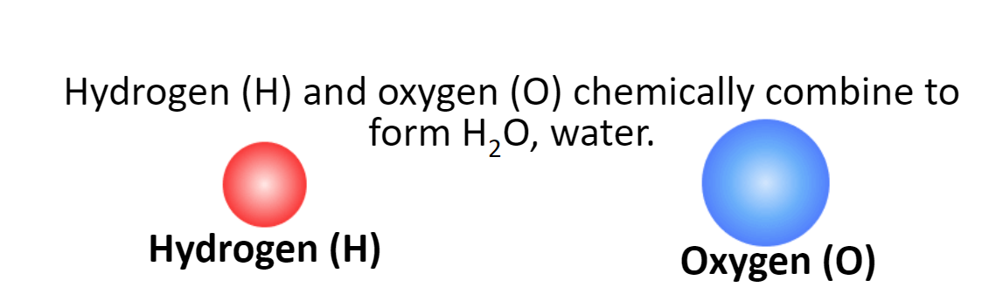
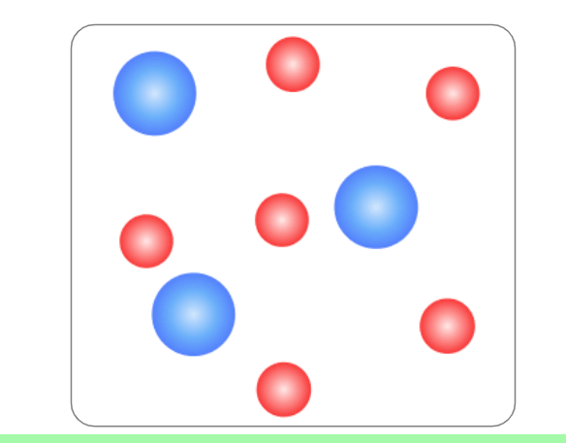
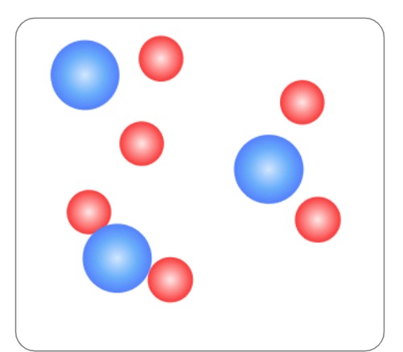
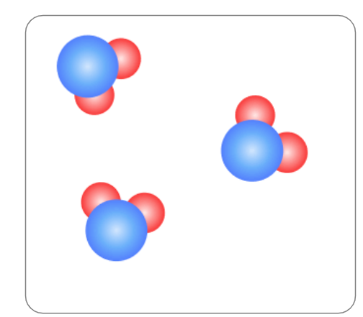
The law of conservation mass

Slide 20
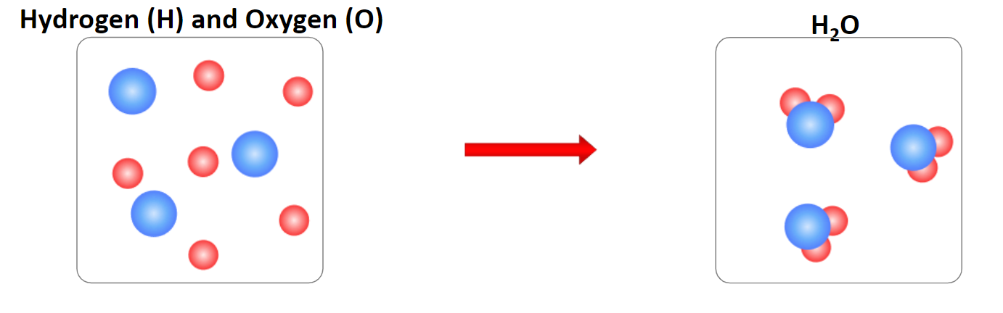
In a chemical reaction, the amount of matter is the same before and after the reaction has taken place.
The structure of the atoms have changed, but no atoms are created or destroyed during the reaction.

Slide 21
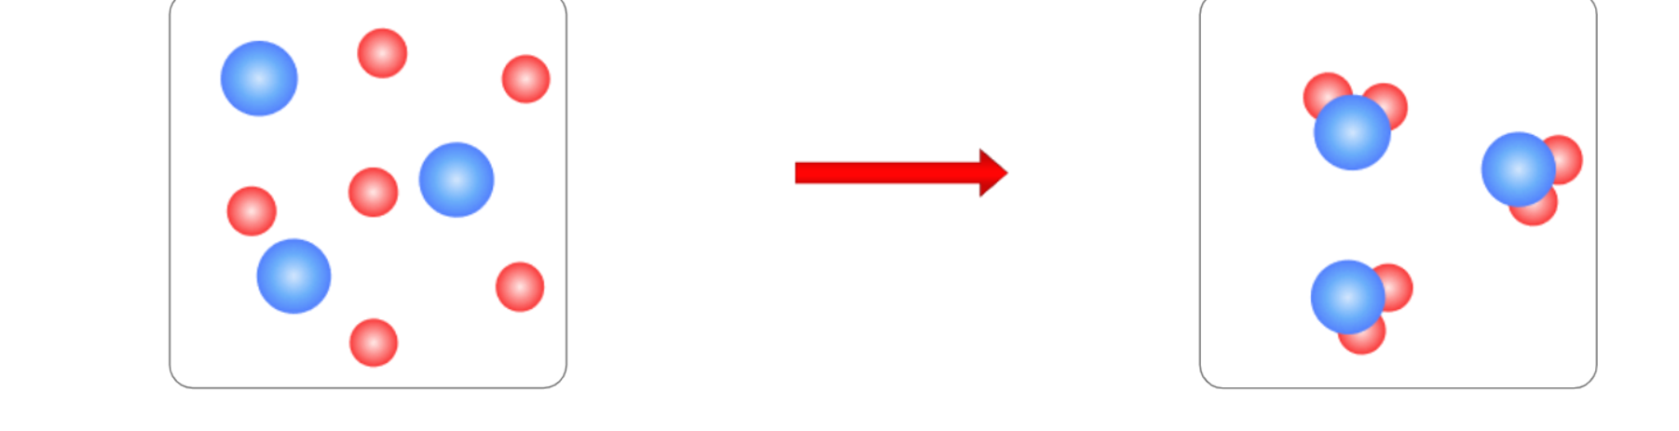
Identify the reactants and the product in the chemical reaction and draw a particle diagram for both the reactants and products.
Hydrogen (H₂) + oxygen (O) water (H₂O)

Slide 22
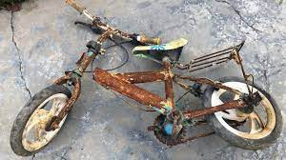

Iron (Fe) reacts with oxygen (O₂) to form the product iron oxide (Fe₂O₃)
Fe₂ + O₃ → Fe₂O₃
= Iron (Fe)
= Oxygen (O)

Slide 23
Draw a particle model diagram for the following:
Nitrogen (N) + Hydrogen (H₃) Ammonia (NH₃)
Particle diagram:

Slide 24
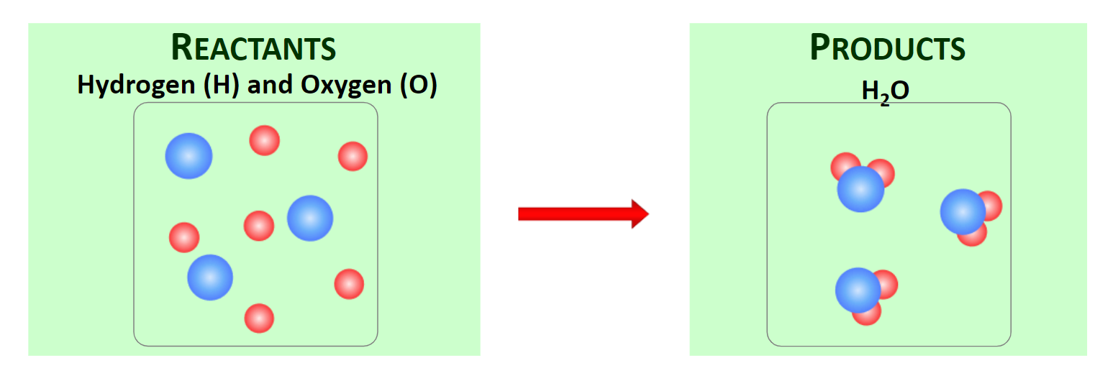
Hydrogen atoms
 | Reactants | Product
Hydrogen atoms
Oxygen atoms
Oxygen atoms

Slide 25
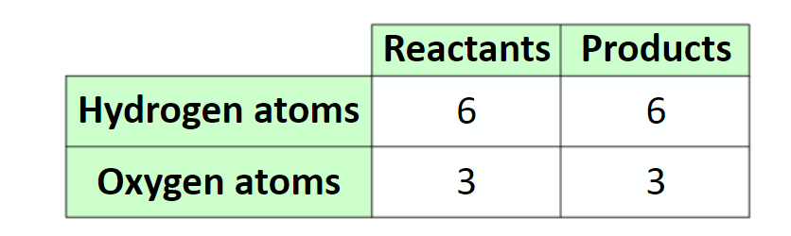

Slide 26
Iron (Fe) reacts with oxygen (O₂) to form the product iron oxide (Fe₂O₃)
Fe₂ + O₃ → Fe₂O₃
 | Reactants | Product
Iron atoms
Oxygen atoms
= Iron (Fe)
= Oxygen (O)

Slide 27
According to the law of conservation how much Zinc was produced?
Hydrogen + Oxygen ca water
20 g 40 g g
Total mass of reactant = Total mass of products
Question:
Find how much zinc was produced?

Slide 28
According to the law of conservation how much Zinc was produced?
Calcium + Zinc carbonate calcium carbonate + zinc
20 g 40 g 45 g xg
Question:
Find how much zinc was produced?

Slide 29
Quiz
A __________ is when a chemical reaction occurs and a new substance is formed.
A __________ is when matter changes state or shape but no new substance is formed.
Changing state is an example of a ____________. Burning paper is an example of a ___________.

Slide 30
Quiz
A chemical change is when a chemical reaction occurs and a new substance is formed.
A physical change is when matter changes state or shape but no new substance is formed.
Changing state is an example of a physical change. Burning paper is an example of a chemical change .

Slide 31
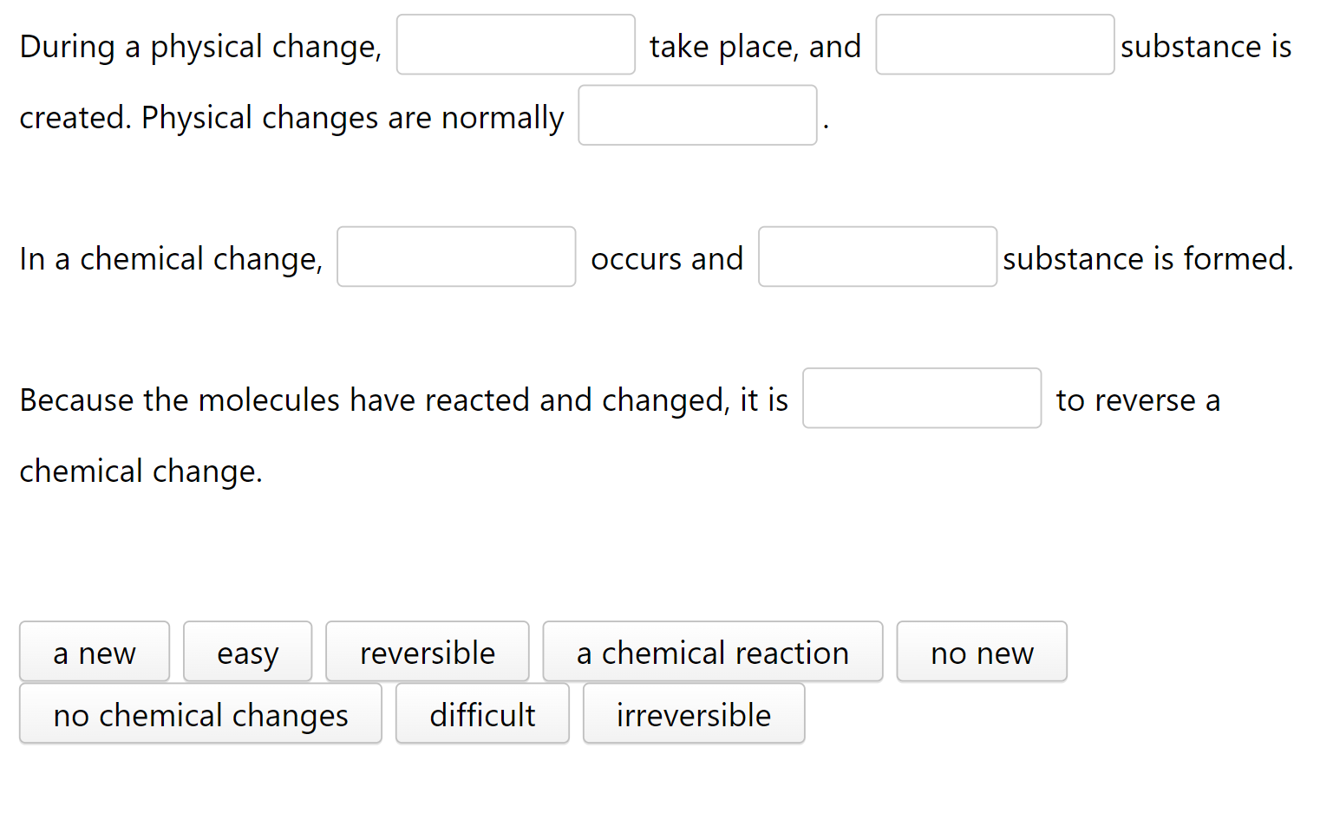
Fill in the word that completes the sentence

Slide 32
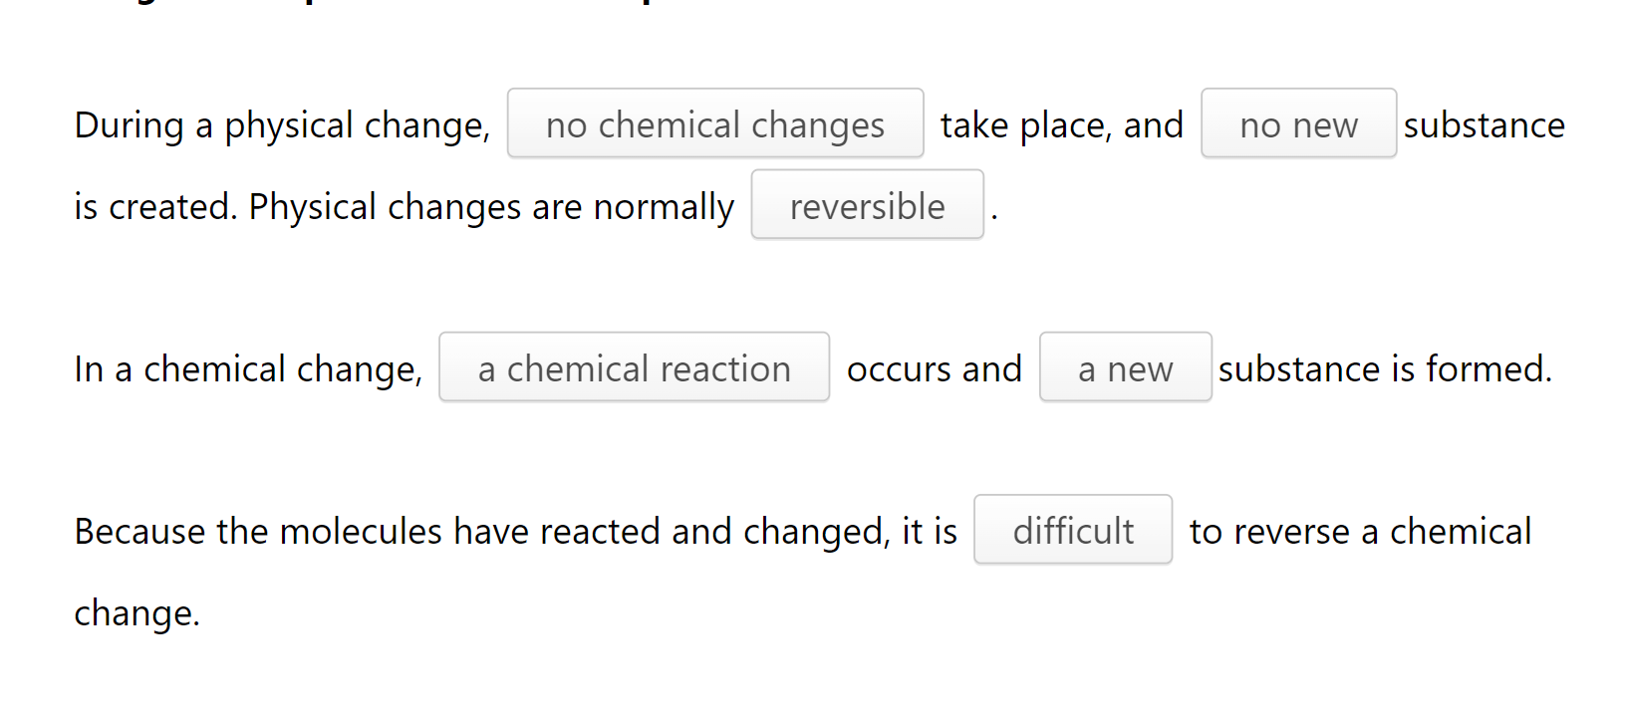

Slide 33
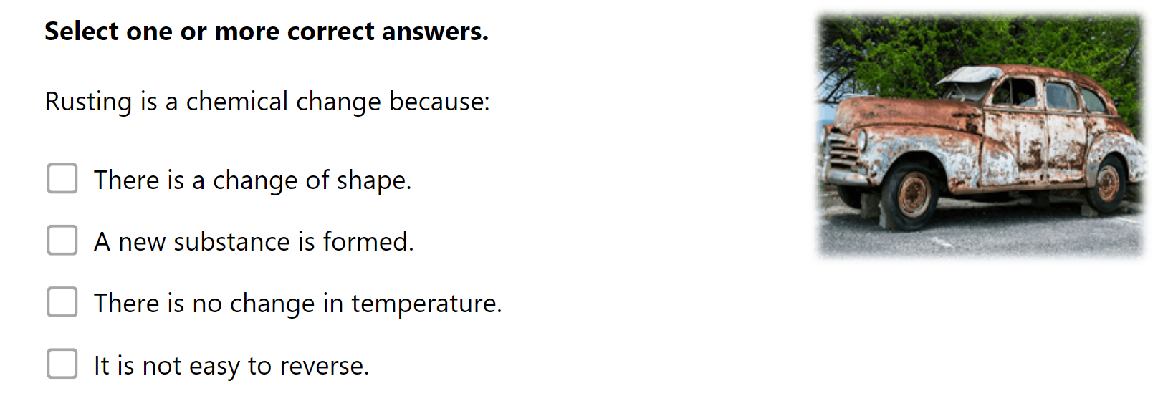
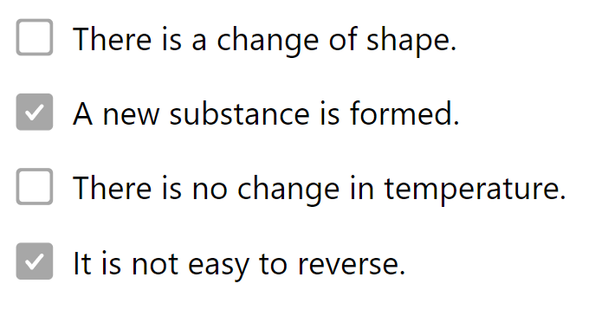

Slide 34
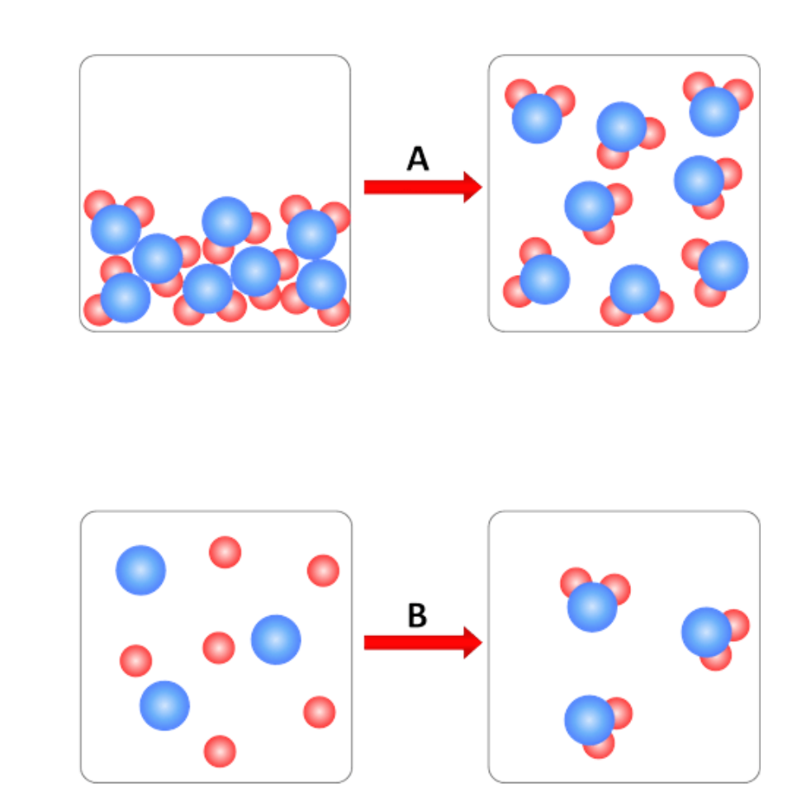
Which image shows a chemical change:
A or B

Slide 35
Which image shows a chemical change:
A or B

Slide 36
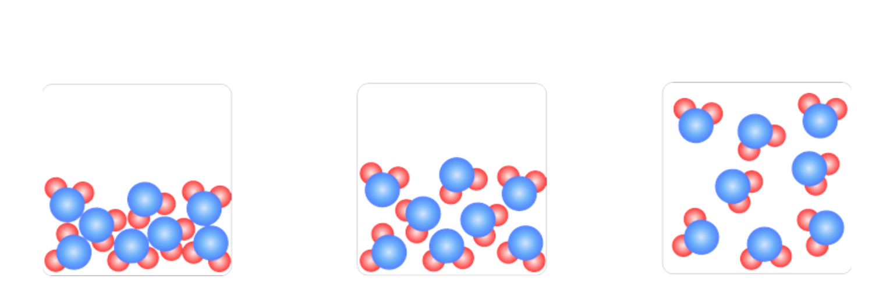
Which image represents water in liquid form
A
B
C

Slide 37
Which image represents water in liquid form
B

Slide 38
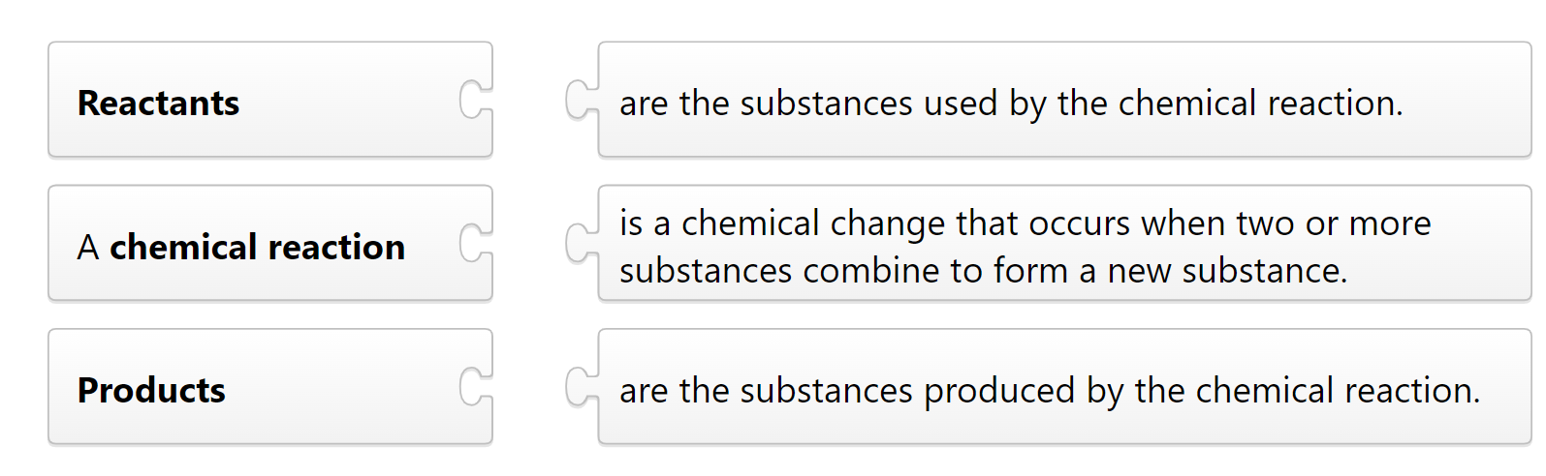
Match the following items

Slide 39
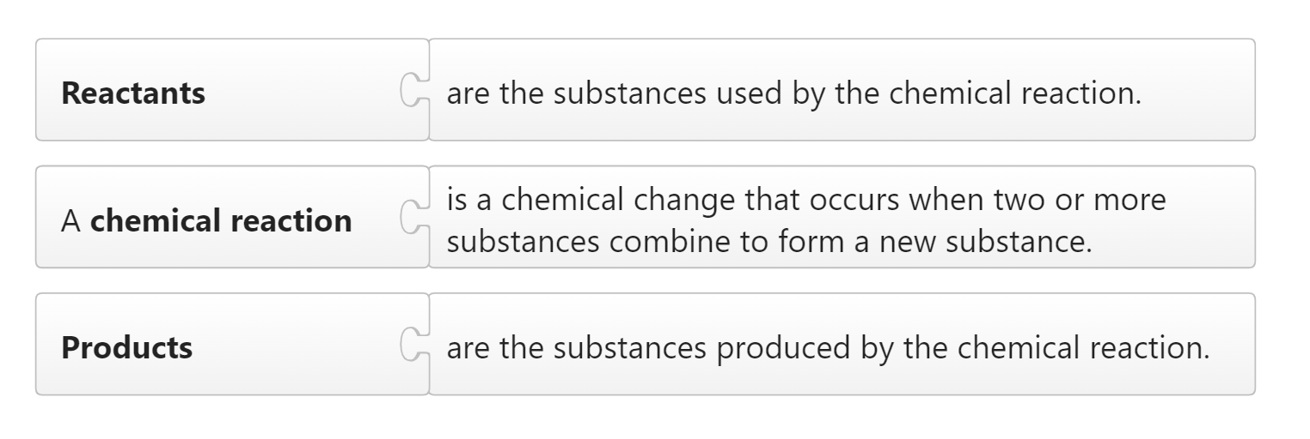
Match the following items

Slide 40
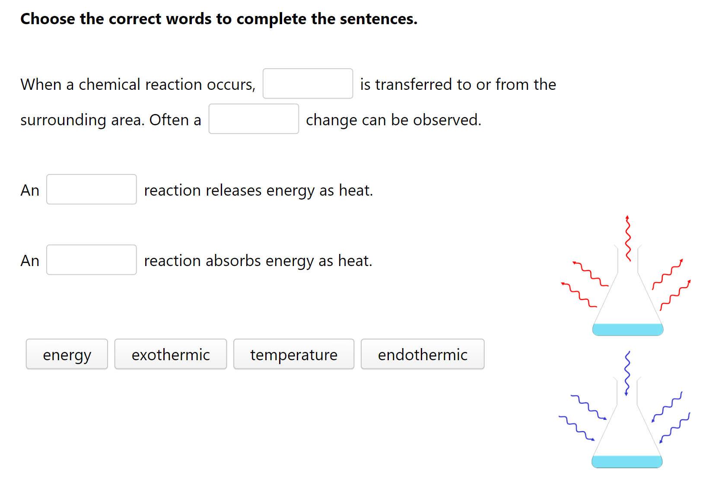

Slide 41
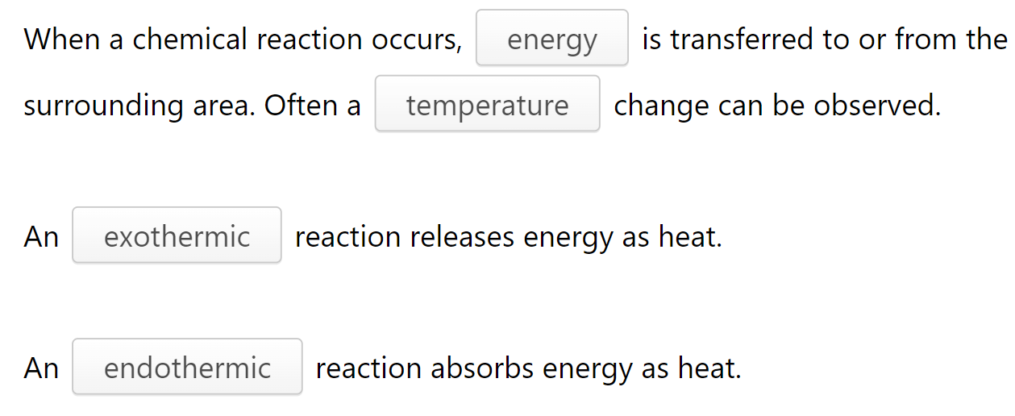

Slide 42
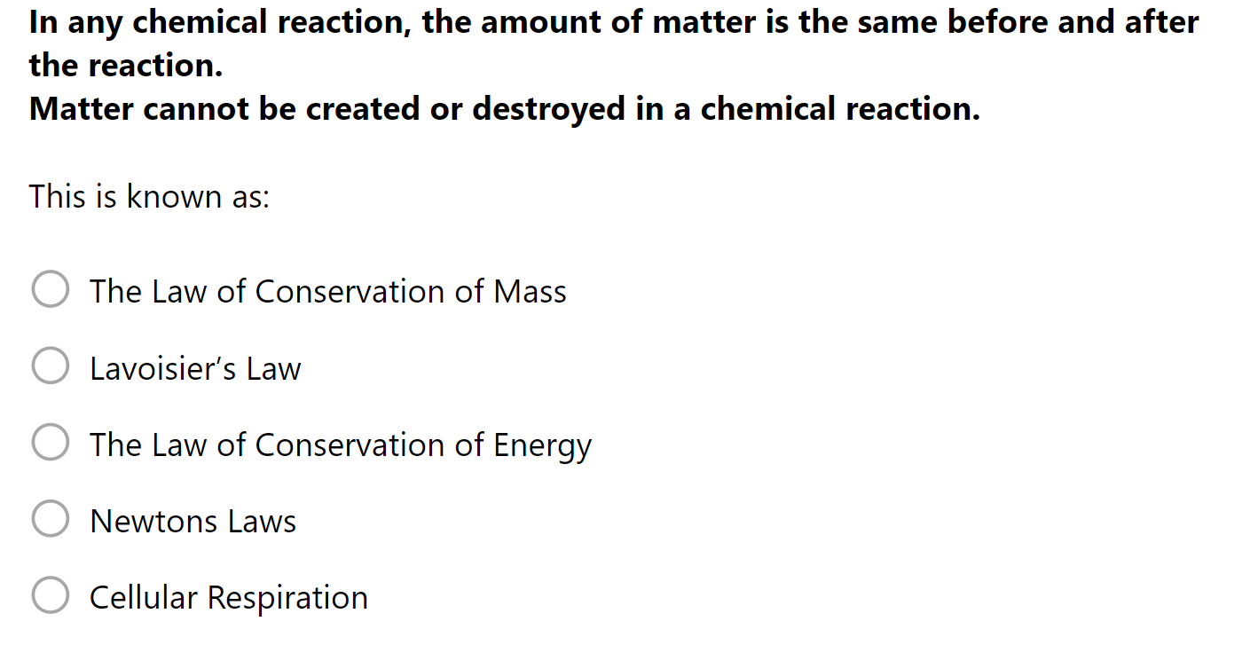

Slide 43
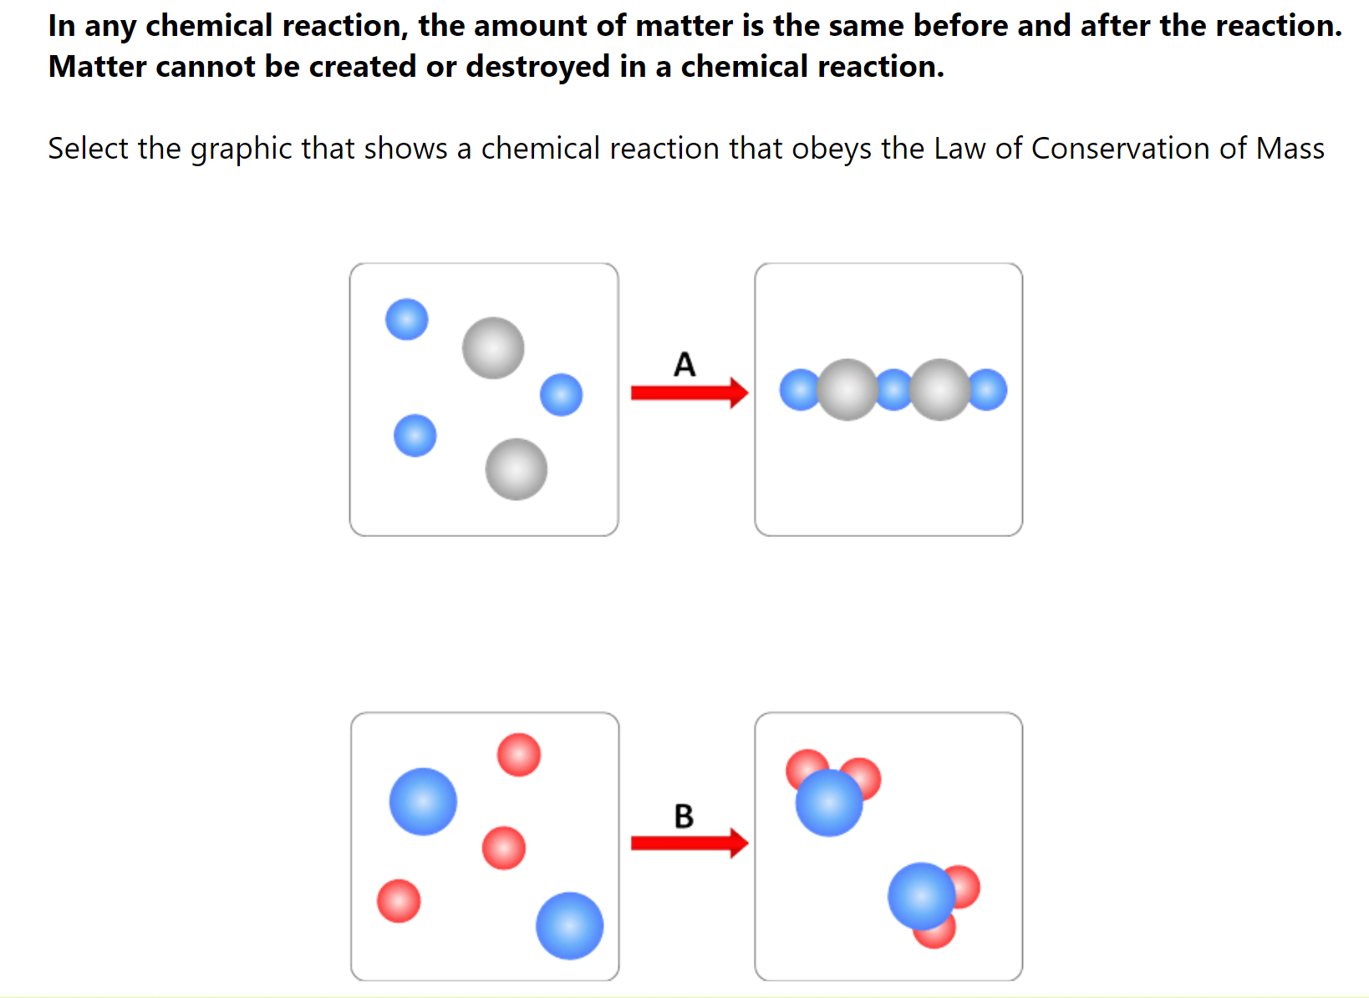

Slide 44
